Slide 1
Machine learning:
prediction,
classification and
clustering
UBB Faculty of Sociology

Slide 2
Hello!
I’m Sergiu Zaharie
Machine Learning Engineer / Data Scientist
Senior Data Scientist @BetFair Romania Development
zahariesergiu@gmail.com
+40742087160
https://www.linkedin.com/in/zahariesergiu/

Slide 3
Course Agenda
#1 Intro, Simple Linear Regression
#2 Python recap, Git, Handling data, EDA
#3 Regression, Decision Trees
#4 Bias, Variance, Overfitting, Classification, Metrics
#5 Random Forest Classifier, Clustering
#6 Neural Newtorks
#7 Help Final Project
#8 Help Final Project

Slide 4
How it works
- Grade based on attendance, participation and final project. - Collaborative course: Google Colab as our main support.

Slide 5
#1.1 What is Machine Learning
#1.2 Visual example
#1.3 Classification Exercise
#1.4 What is Machine Learning?
#1.5 Types of Machine Learning
#1.6 App examples exercise
#1.7 Simple Linear Regression
#1.8 Questions & Further reading
1. Intro to
Machine Learning

Slide 6
1.1 What is Machine Learning?
How many people here have heard about machine learning?

Slide 7
How many people here have heard about machine learning?
How many people here have done some kind of machine learning course, training, or technical reading?

Slide 8
How many people here have heard about machine learning?
How many people here have done some kind of machine learning course, training, or technical reading?
ML VS AI?
Machine Learning is a subset of Artificial Intelligence that enables systems to learn from data, while AI covers all technologies that mimic human intelligence.
Non ML: Chatboots, hard-coded AI game

Slide 9
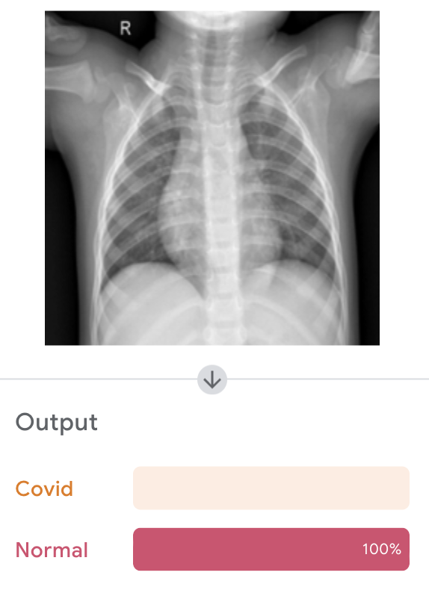
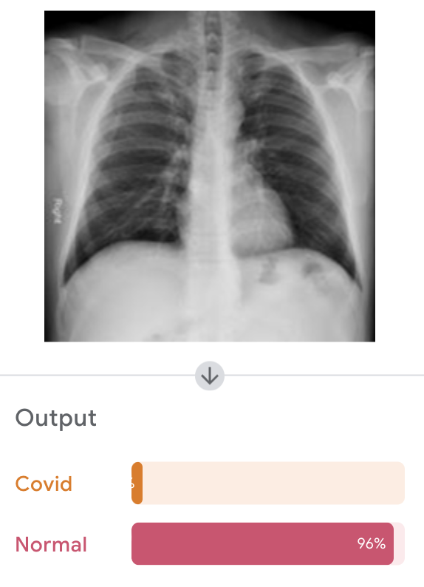
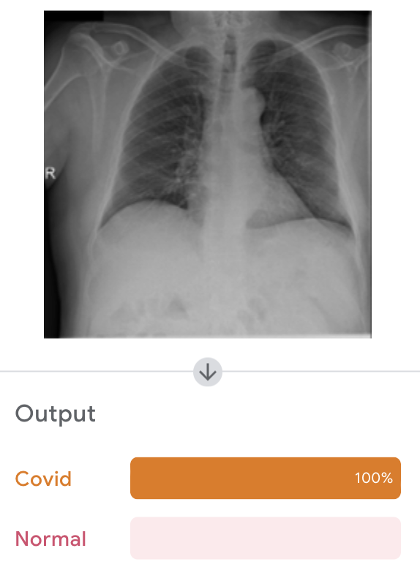
1.2 Visual Example
https://teachablemachine.withgoogle.com/

Slide 10
Always about single tasks.
A particular machine learning system only ever “does one thing”
a single function.

Slide 11


#1.1 Classification exercise
1.3 Classification exercise
Suppose you want to build a dataset for Decathlon to classify runners and bikers by reading smartwatch data.
You’ll get to ask everyone in your city park questions, to collect data.
What questions do you ask?

Slide 12
Suppose you want to build a dataset for Decathlon to classify runners and bikers by reading smartwatch data.
You’ll get to ask everyone in your city park questions, to collect data.
What questions do you ask?
What is your average speed during this activity?
Purpose: Speed is a critical factor, as bikers typically move faster than runners.
What is your average heart rate while performing this activity?
Purpose: Runners and bikers may have distinct heart rate patterns due to the intensity and nature of the activity.
Are you currently moving or stationary during your activity?
Purpose: This helps capture whether the individual is in an active phase, like running or cycling, versus resting or pausing.

Slide 13
These will be features for your classification model
What is your maximum speed during this activity?
Purpose: Maximum speed can help differentiate between runners (lower max speeds) and bikers (higher max speeds).
What is the typical cadence or step rate you maintain during this activity?
Purpose: Runners have step counts (e.g., strides per minute), while bikers might have a pedal cadence.
Do you take any rest breaks during this activity?
Purpose: Identifying rest periods and how they reflect in the smartwatch data could help classification.
Do you experience frequent stops during your activity, such as at traffic lights or intersections?
Purpose: Helps differentiate bikers (who often stop more frequently) from runners (who may have more continuous movement).
Do you notice significant elevation changes during your activity?
Purpose: Bikers might cover longer elevation profiles, while runners might prefer flatter terrains. Or reversed i.e. trail running
What is the duration of your typical session?
Purpose: Bikers often engage in longer sessions compared to runners.

Slide 14
1.4 What is Machine Learning?
"Machine learning is the science of getting computers to act without being explicitly programmed."
Andrew Ng

Slide 15
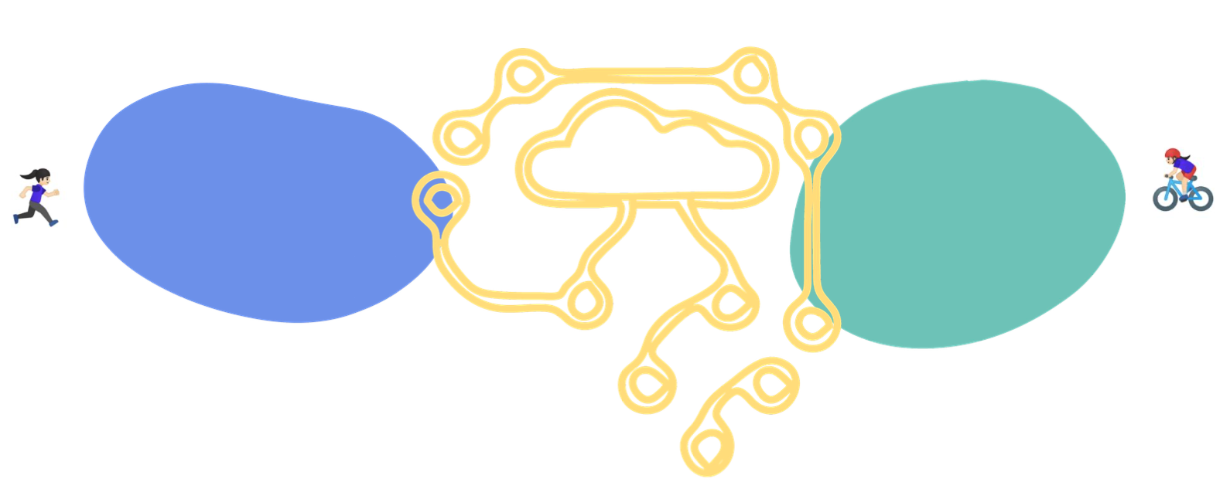
Goal of machine learning is to go from observed quantifiable characteristics to unobserved quantifiable characteristics.
Looking at past cases, what would I guess to be the case?
Machine learning is basically fancy ways of asking this question, by associating “features”
“This feature was often associated with riding a biking.”

Slide 16
#1.1 What is Machine Learning?
"Machine learning is the science of getting computers to act without being explicitly programmed."
Andrew Ng

Slide 17
#1.1 What is Machine Learning?
"Machine learning is the science of getting computers to act without being explicitly programmed."
Andrew Ng
Machine learning is how we teach computers to learn from examples instead of giving them step-by-step instructions.

Slide 18
#1.1 What is Machine Learning?
"Machine learning is the science of getting computers to act without being explicitly programmed."
Andrew Ng
Machine learning is how we teach computers to learn from examples instead of giving them step-by-step instructions.
Algorithms that are able to generalize from patterns
learned from data samples

Slide 19
Model Interaction
Data
Data Preparation
Model Evaluating
Model Output
Model Building

Slide 20
Data
All machine learning models need data
Where does your data come from?
What is the type (string/integer) of each of the features (columns)
Train data - data to train on
Test data – Keep out of training, used only for testing the model.

Slide 21
Data Preprocess
Explore your data - look for trends that might inform you
Remember - how was your data collected?
How is it going to be used?
Format the data in a way that the computer can read it
Clean
Normalize - adjusting your data to a common scale ●
Might choose to exclude missing values
Feature engineer etc

Slide 22
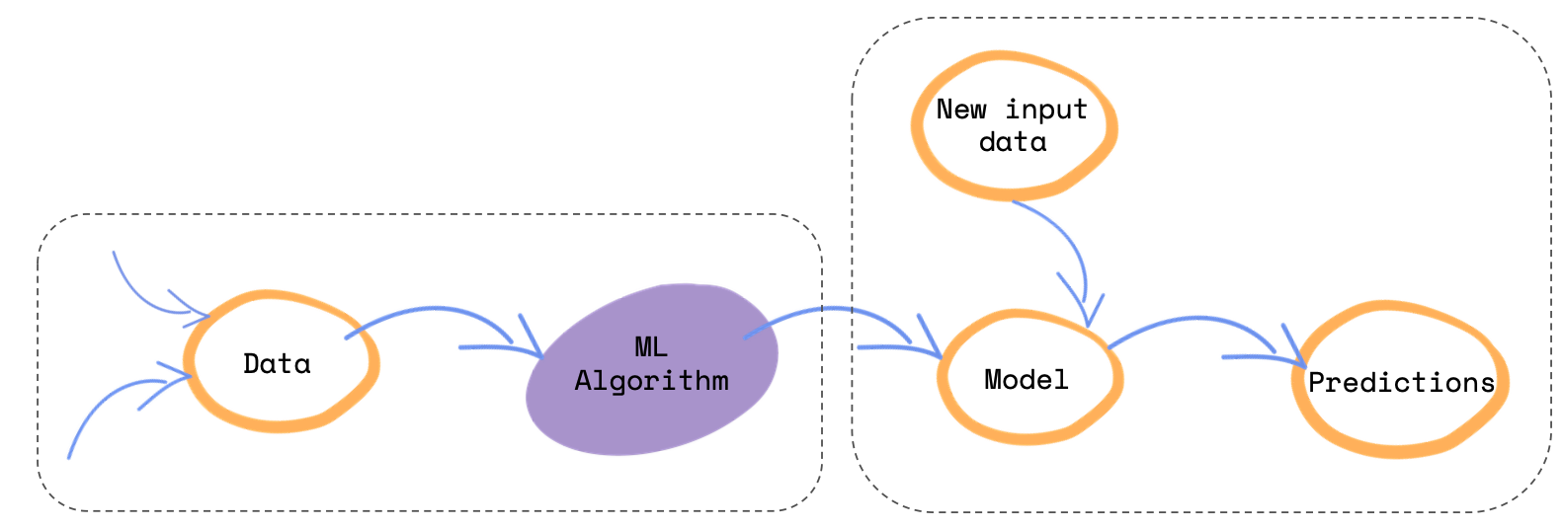
Model Building
Ask yourself: What type of problem are you trying to solve?
Data + Algorithm = Model ● Algorithm:
Clustering, Regression, Decision Tree etc.

Slide 23
Model Evaluation
How well can your model [predict] unseen data?
Train data - data to train on
Test data – Keep out of training, used only for testing the model.
Metrics:
Accuray fractions pf predictions model got right
Precision - proportions of positive predictions that are correct
Recall - proportions of actual positives that are correctly identified
MSE - mean squared difference between actual and predicted
RMSE - root mean squared difference between actual and predicted

Slide 24
Model Output
What will the output of your model look like?
Regression Models
Output: Continuous numeric values (e.g., predicted price, loan amount, temperature).
Classification / Decision Models
Should the system explain why a loan is denied (e.g. insufficient income) to comply with regulations ?
Output: Approve / Deny, or class probabilities / scores.
Recommendation / Ranking Models
Helps users discover relevant products or content; can improve engagement and retention. How many? Sorted or not?
Output: Top-N recommendations or ranked items based on user preferences, behavior, or relevance scores.
Sequence / Time Series Models
Predictions can be deterministic (single value) or probabilistic (distribution / prediction intervals) to reflect uncertainty in future outcomes.
Output: Predicted sequences of values (e.g., stock prices, demand forecasts, next words in text).

Slide 25
Model Interactions
- How do you give feedback to your model?
- How can you leverage the model capabilities to make it more impactful?
- What do you need to do to transform the model output to make it usable?
Examples:
Collect user feedback
Regulary add examples of user queries for diverse contexts
Monitor outputs for biases or errors and correct the in the training data
User experience - design to improve usability

Slide 26
1.5 Types of Machine Learning
Supervised Learning
Regression - Interpolating data: generate a point
Classification - Label data: dog or cat
Unsupervised Learning
Clustering - Group data
Reinforcement learning

Slide 27
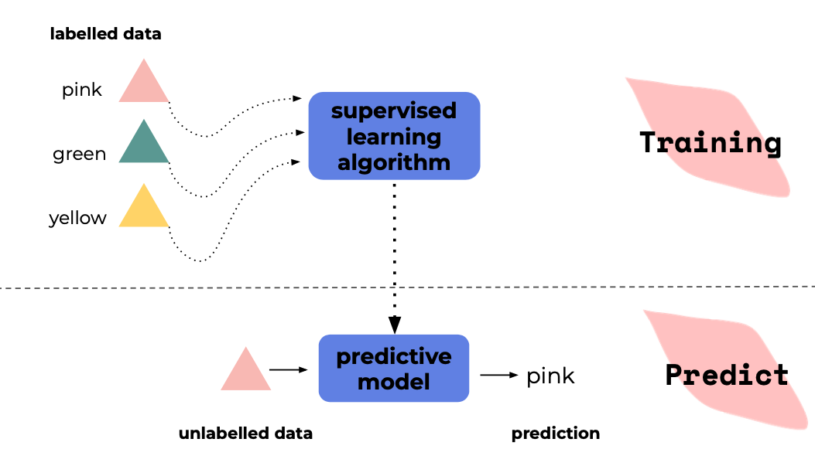
Supervised Learning

Slide 28
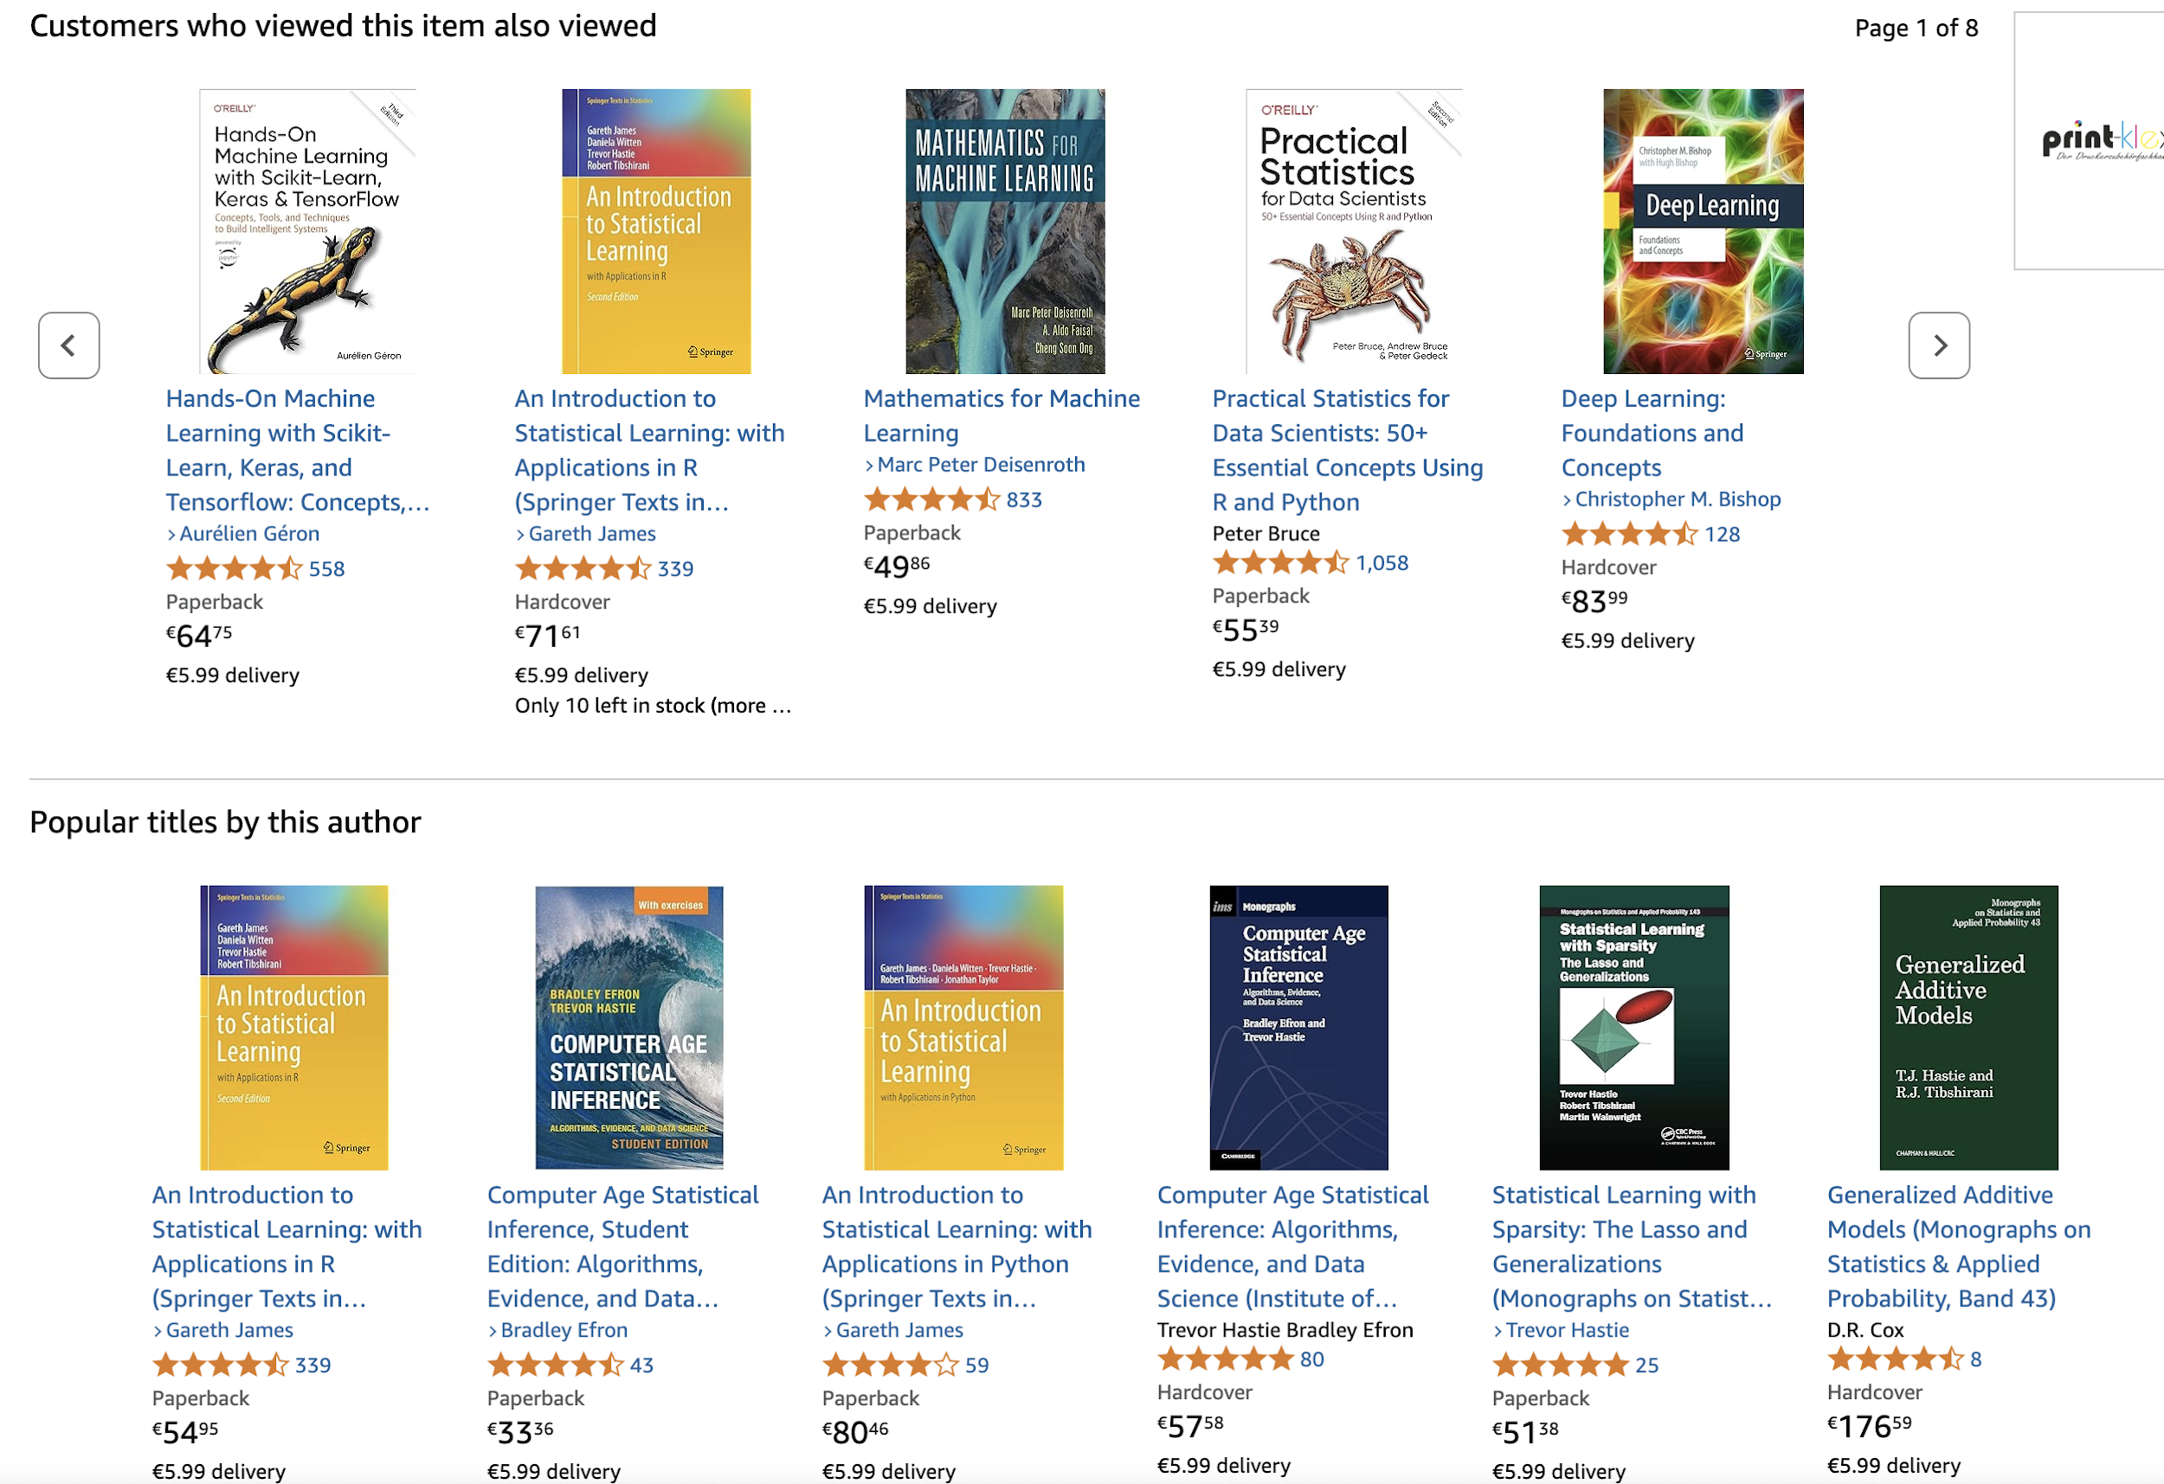
Amazon recommendations

Slide 29
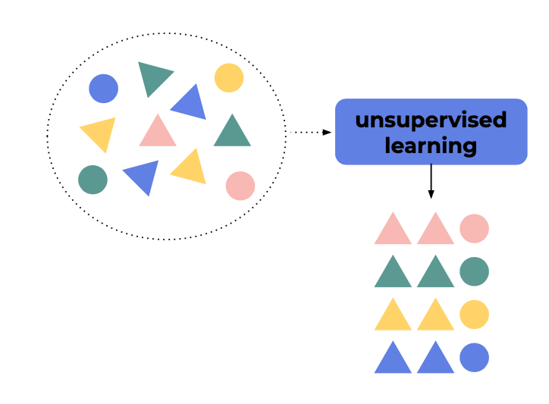
Unsupervised Learning

Slide 30
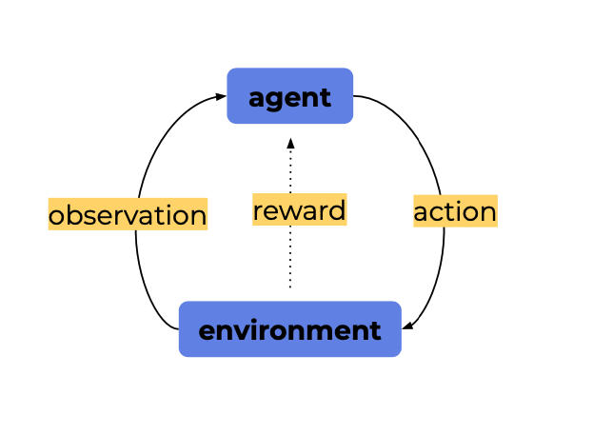
Reinforcement learning
Reinforcement learning is a type of machine learning where an agent interacts with an environment by taking actions, observing the resulting states, and receiving rewards.
Through this feedback loop, the agent learns to choose actions that maximize cumulative rewards over time.

Slide 31

AlphaGo
https://youtu.be/WXuK6gekU1Y

Slide 32
1.6 App Examples Exercises
Describe a few real applications, where classification can be useful.
Describe y variable (label, target) and the X variables (features, predictors, attribute),
Same for regression.

Slide 33
Classification Binary: y∈{0,1}
Email Spam Detection: Predict whether an email is spam or not.
Features : Word Frequency (numerical continuous), Email Length (numerical continuous), Attachment Presence (categorical binary).
Target: Spam or Not Spam.
Credit Card Fraud Detection: Detect whether a credit card transaction is fraudulent\
Features: Transaction Amount (numerical continuous), Time (numerical continuous or discrete), Merchant Category (categorical nominal), Device Type (categorical nominal).
Target: Fraud or Not Fraud.
Classification Multiclass: y∈{0, 1, 2, 3, …}
Image Recognition: Classify images into categories like cat, dog, or bird.
Features: Pixel Intensity Values (numerical continuous).
Target: Cat or dog or bird
Predicting Weather: Classify weather into categories: sunny, cloudy, rainy, or snowy.
Features: Temperature (numerical continuous), Humidity (numerical continuous), Wind Speed (numerical continuous), Pressure (numerical continuous).
Target: Sunny or cloudy or rainy or snowy.
Classification Multilabel y∈{0,1} for each class
Multi-Genre Movie Classification: Assign multiple genres (e.g., Action, Comedy, Drama, Family) to a movie.
Features: Movie Description (textual unstructured), Director (categorical nominal), Cast (categorical nominal), Keywords (categorical nominal).
Target: 0 or more: Action, Comedy, Drama, Family
Tagging News Articles: Assign multiple tags (e.g., Politics, Sports, Technology) to a news article.
Features: Article Text (textual unstructured), Title (textual unstructured), Keywords (categorical nominal).
Target: 0 or more: Politics, Sports, Technology
Regression: y∈R, continuous value
Predicting Stock Prices: Forecast the closing price of a stock.
Features: Opening Price (numerical continuous), Daily High/Low (numerical continuous), Trading Volume (numerical continuous), Market Sentiment (numerical continuous or categorical ordinal).
Target: Closing stock price as continuous value
Predicting Employee Salaries: Estimate an employee's salary in dollars.
Features: Years of Experience (numerical continuous), Education Level (categorical ordinal), Job Role (categorical nominal), Location (categorical nominal)
Target: Salary as continuous value

Slide 34
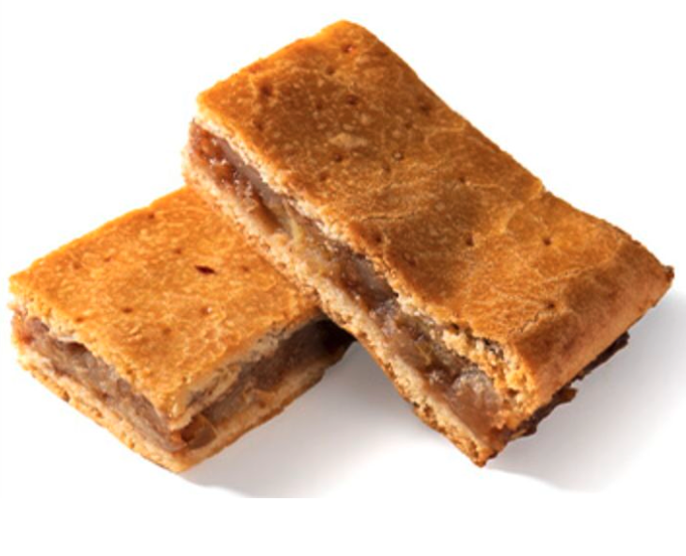
Apple pie recipe
1.7 Simple Linear Regression
What’s inside:
1 kg apples
1 secret ingredient
random pie ingredients
Mix ingredients. Put in the oven.
Take a break. Enjoy.

Slide 35
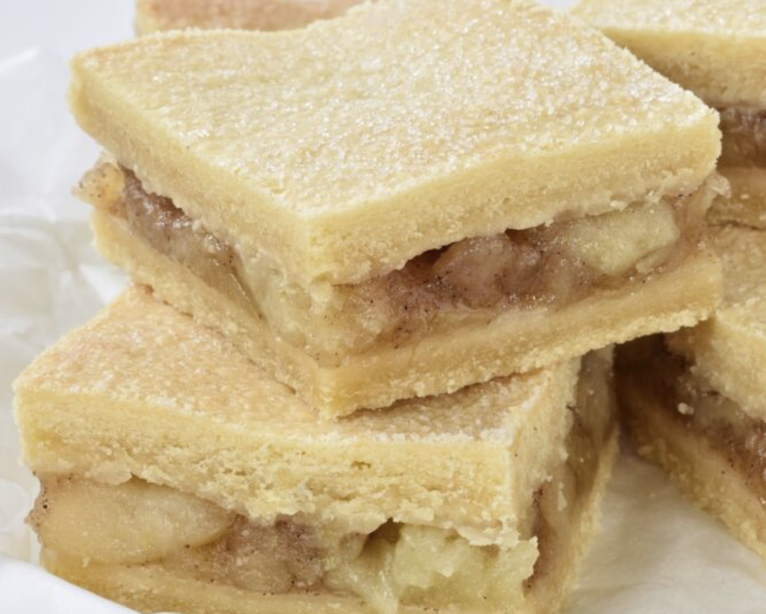
Predict calories in a slice of pie
What’s inside:
1 kg apples
1 secret ingredient
random pie ingredients

Slide 36
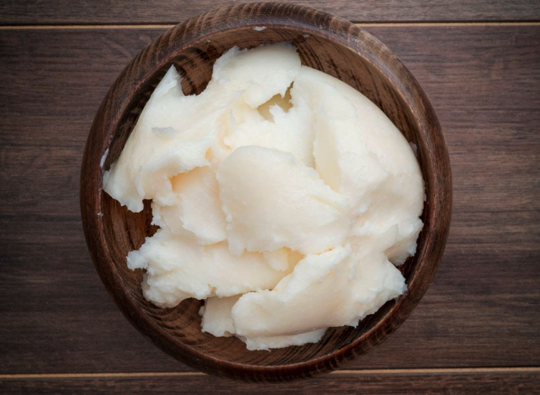
Predict calories in a slice of pie
227 calories
What’s inside:
1 kg apples
100 g of lard (untura)
random pie ingredients

Slide 37
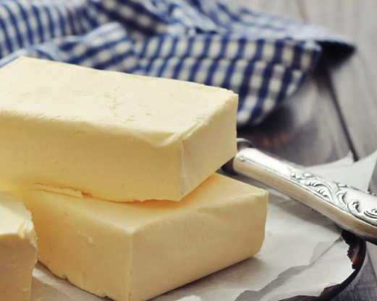
Predict calories in a slice of pie
203 calories
What’s inside:
1 kg apples
80 g of butter
random pie ingredients

Slide 38
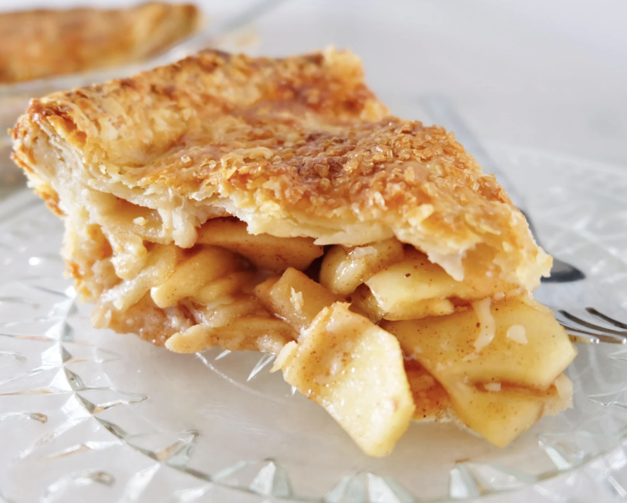
Predict the calories
Calories for 15 apple pie slices:
227, 203, 207, 148, 230,
154, 176, 290, 167, 245,
176, 259, 251, 503, 191

Slide 39
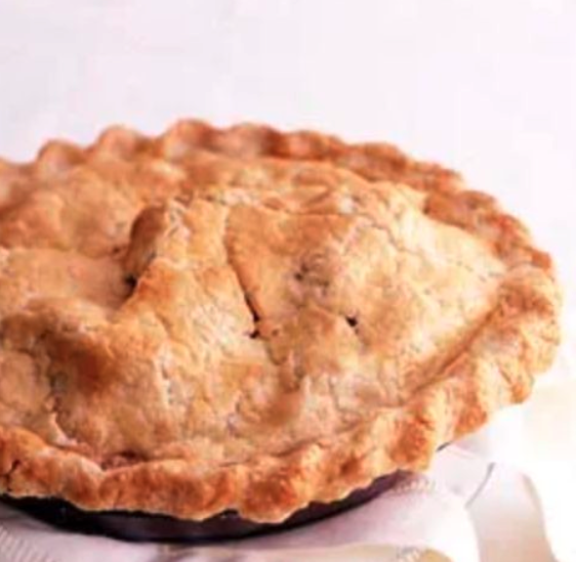
Predict the calories
Calories for 15 apple pie slices:
148, 154, 167, 176, 176,
191, 203, 207, 227, 230,
245, 251, 259, 290, 503
Mean: 228,47
Median: 207

Slide 40

Predict calories in a slice of pie
130 calories
What’s inside:
1 kg apples
20 g of dates (curmale)
random pie ingredients

Slide 41
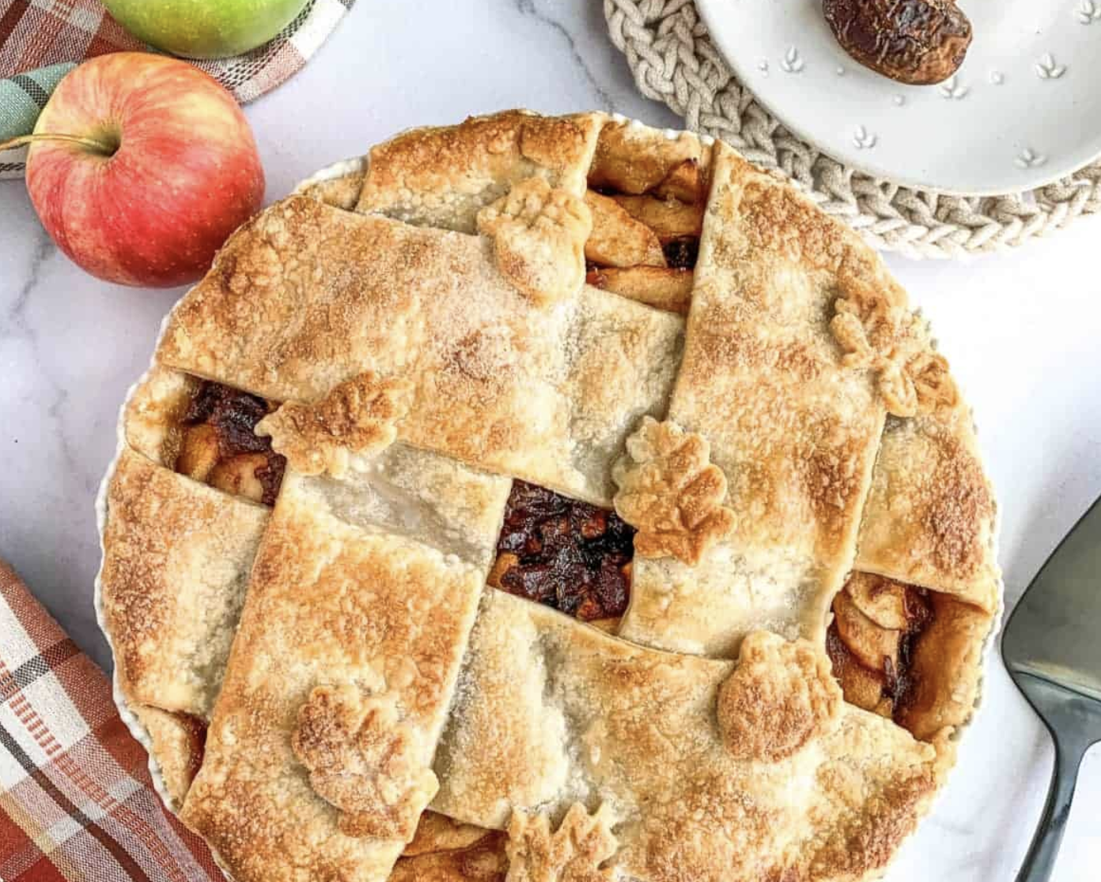
Predict calories in a slice of pie
131 calories
What’s inside:
1 kg apples
20 g of dates (curmale)
random pie ingredients
How did we do?
Mean = 228
Did we overestimate? Error = 228-131 = 97

Slide 42
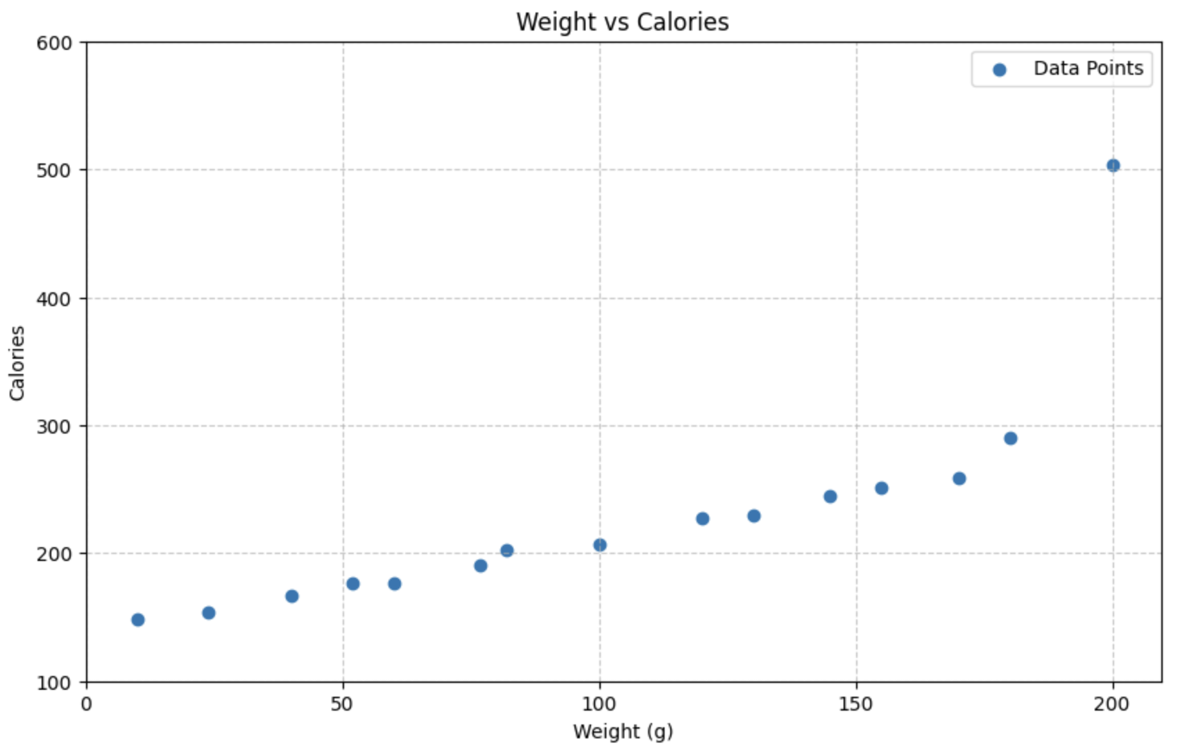
Predict calories

Slide 43
Predict calories
Eq of the line: y = ax + b
Where:
a: slope
b: intercept
x: data
How lines work:
Calories =
Slope * Weight + Intercept

Slide 44
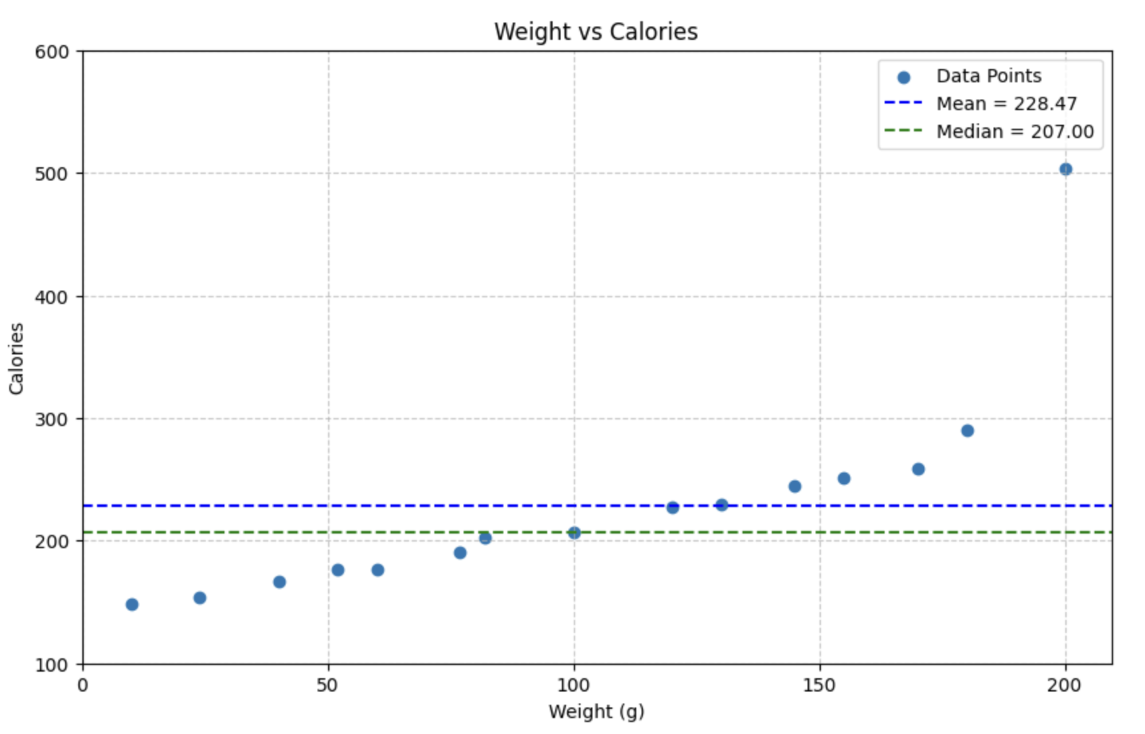
Predict calories
Eq of the line: y = ax + b
Where:
a: slope
b: intercept
x: data
How lines work:
Calories =
0 * Weight + 228

Slide 45
Let’s find a line that’s as close to the points as possible! Define error as point - line. If we want a line close to the points, we don’t like errors. An easy function of the errors to minimize is root mean squared error (RMSE).

Slide 46
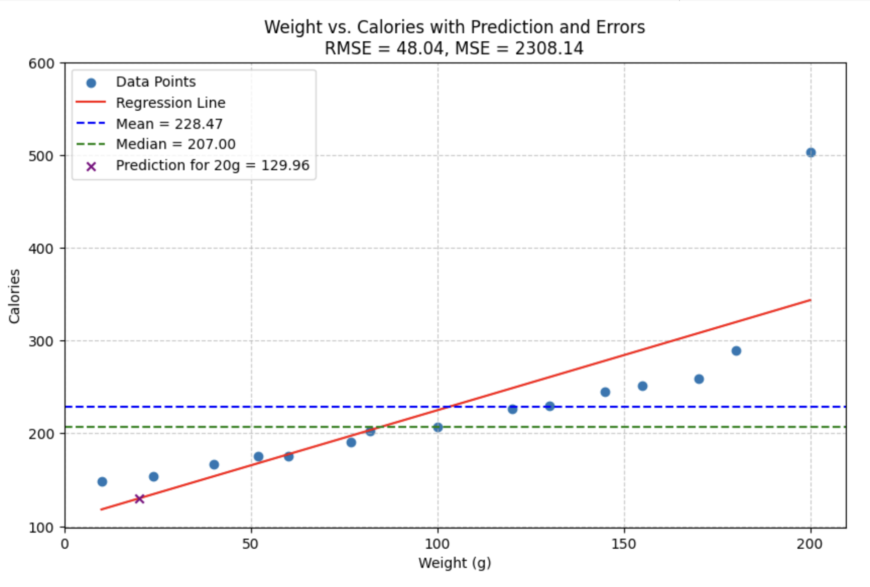
Predict calories
Eq of the line: y = ax + b
Where:
a: slope
b: intercept
x: data
How lines work:
Calories =
1.187 * Weight + 106.2
Code on Colab

Slide 47
Predict calories
Eq of the line: y = ax + b
Where:
a: slope
b: intercept
x: data
How lines work:
Calories =
1.187 * Weight + 106.2 = 129.94
Code on Colab

Slide 48
Data is not always linear
No problem!
There are non-linear regression models:
● Decision Tree Regression
● SVM with non-linear kernels
● Neural networks
● KNN
● Ensemble methods

Slide 49
1.8 Questions & Further reading
#1 Google machine learning glossary: https://developers.google.com/machine-learning/glossary
#2 What is machine learning: https://www.youtube.com/watch?v=iLu9XyZ55oI
#3 Steps of Machine Learning: https://www.youtube.com/watch?v=nKW8Ndu7Mjw&t=394s
#4 Understanding the 3 most common loss functions for Machine Learning Regression: https://towardsdatascience.com/understanding-the-3-most-common-loss-functions-for-machine-learning-regression-23e0ef3e14d3

Slide 50
Thank you !!
Machine Learning Engineer / Data Scientist
zahariesergiu@gmail.com
https://www.linkedin.com/in/zahariesergiu/
https://github.com/zahariesergiu/ubb-sociology-ml

